Slide 1
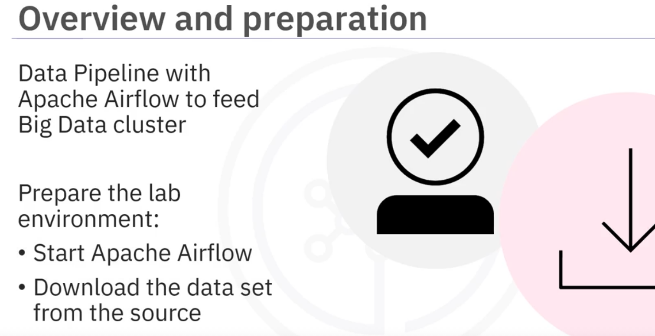
Datapipelines using Apache Airflow
Week-4
In this assignment, you will perform a couple of exercises to create, run and monitor a data pipeline using Apache Airflow to feed the big data cluster from the Web server log.
But before proceeding with the assignment, you will prepare the lab environment by starting Apache Airflow and then (using the link provided) download the data set from the source to the appropriate destination.

Slide 2
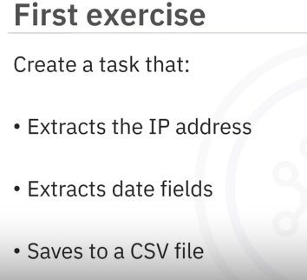
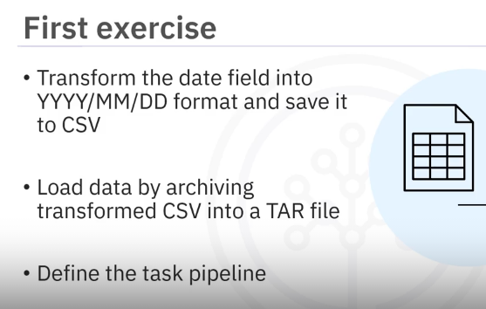
In the first exercise, you will perform a series of tasks to create a directed acyclic graph (DAG) that runs daily.
You will create a task that extracts the IP address and the date fields from the web server log file and then saves them to a CSV file.
The next task requires you to transform the date field into year-month-day format and save the output to a CSV file.
In the final task of the first exercise, you will load the data by archiving the transformed CSV file into a TAR file.
Before moving on to the next exercise, you will define the task pipeline as per the given details.

Slide 3
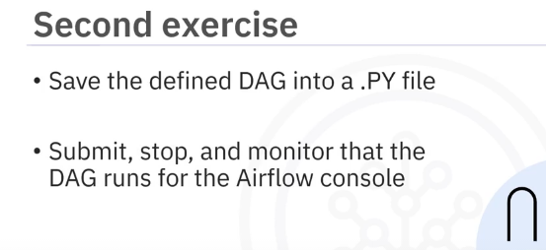
In the second exercise, you will get the DAG operational by saving the defined DAG into a .py (or python) file.
Further, you will submit, stop, and then monitor that the DAG runs for the Airflow console.

